Slide 1

Appointment Bot
Mini Project by:
Srushti Narvekar (16IT6154)
Sneha Kanase (16IT6152)
Akshay Dangare (17IT1075)
Mentor :
Anita Patil Ma’am

Slide 2
Introduction
With all the busy environment, and increasing routine care, its necessary to have a assistant on your daily WhatsApp to guide you throughout. Chatbot applications streamline interactions between people and services, enhancing customer experience.
Assistant Bot helps you schedule your routine activities with reminding you by Google Calendar.
The objective of the thesis is to maximize the convenience to schedule appointments without getting overwhelmed with calls.
Hassle-free appointment scheduling: Patients don’t always have the time to visit the doctor’s clinic personally for making an appointment. A chatbot makes it utterly convenient to manage the requests and confirm them accordingly.
Immediate Patient Assistance: Some matters are urgent and need an on the spot expert opinion. A chatbot can be instrumental in bridging the gap between patients seeking answers and expert doctors who can help.
Saves Time: Both the patient and the clinic staff save the time they spend on scheduling an appointment. Patients can now book an appointment right from their office desk or from the comfort of their home.

Slide 3
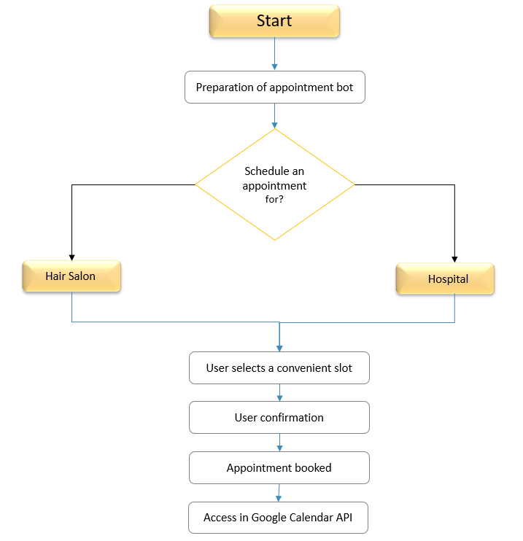

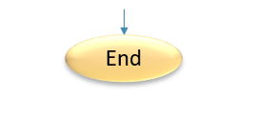
FLOWCHART

Slide 4
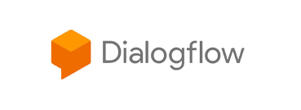
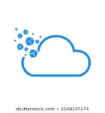


Methodology
Dialogflow
For creating intents
Deployment
For dumping Dialogflow intents
Hosting with Heroku
Hosting WhatsApp
Step 4
Twilio Account
Creating Bot
Step 3
Step 2
Step 1

Slide 5
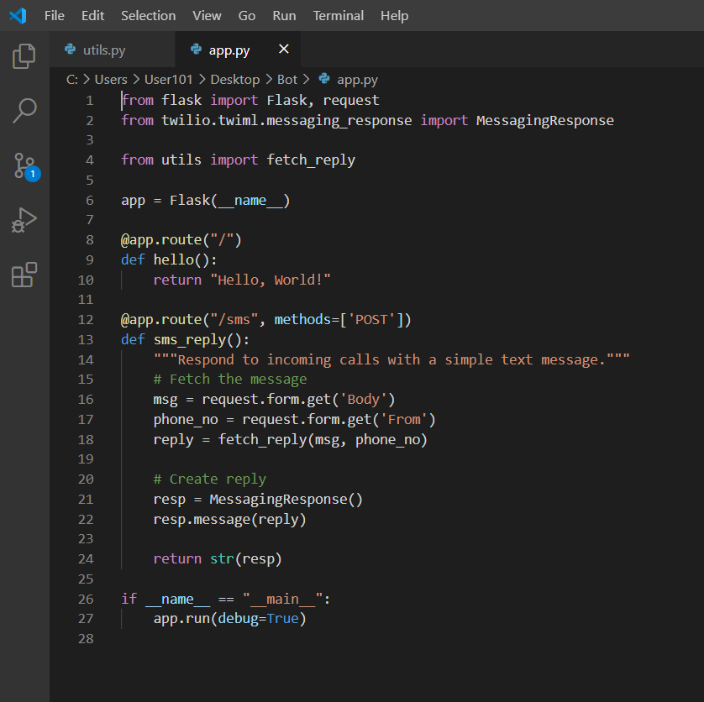
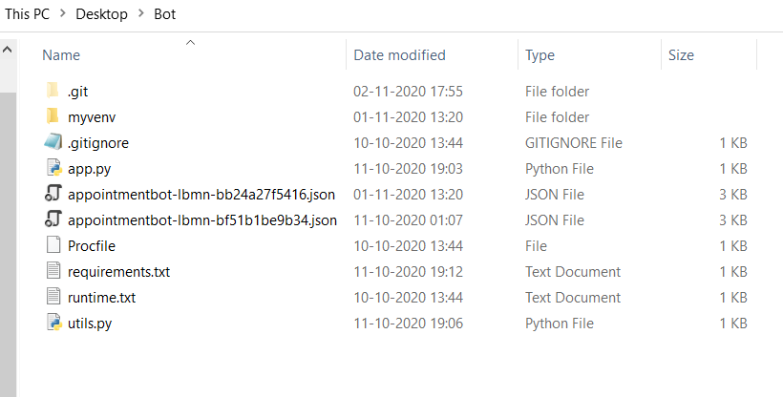
Hosting screenshots

Slide 6
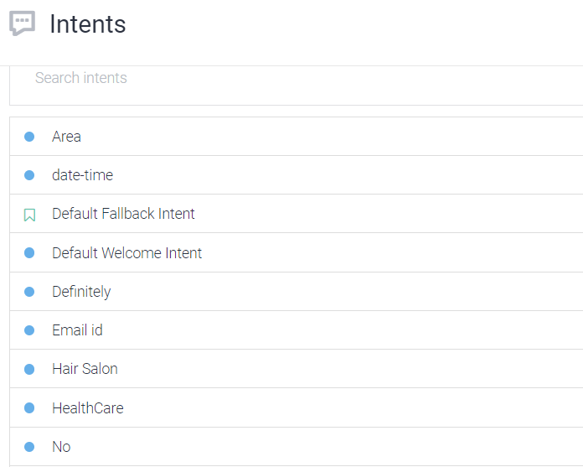
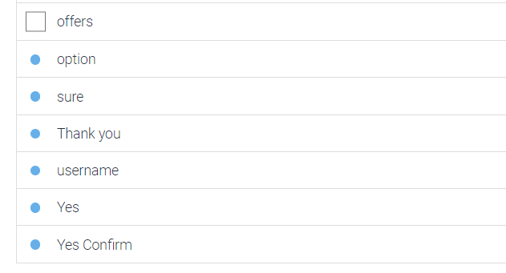
Dialogflow Intents

Slide 7
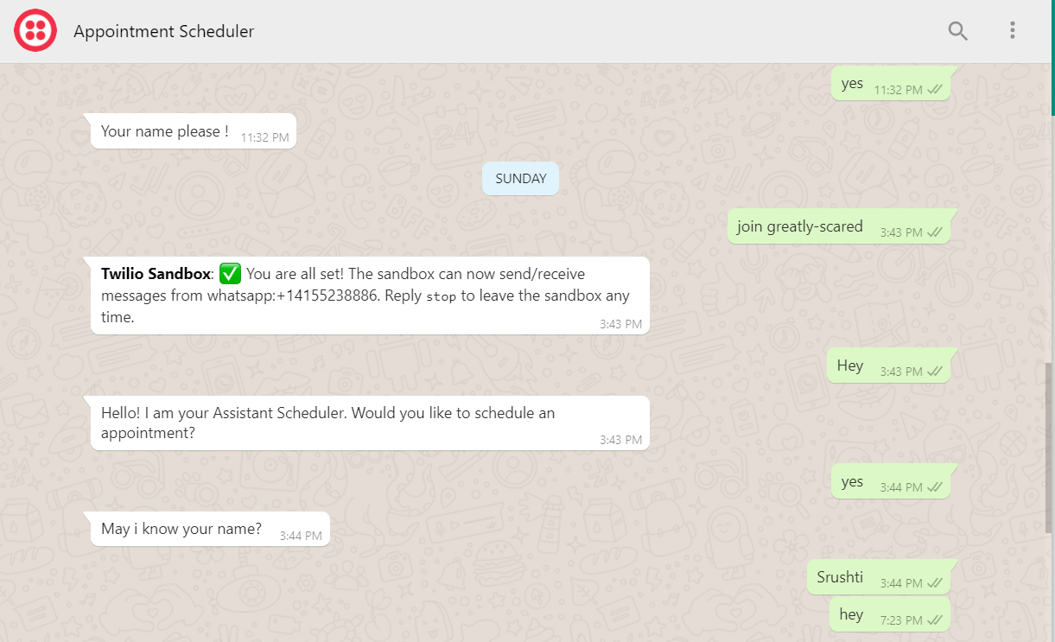
WhatsApp Hosting

Slide 8

ALLPPT Layout
Clean Text Slide
for your Presentation
ChatBot
You can simply impress your audience and add a unique zing and appeal to your Presentations. Get a modern PowerPoint Presentation that is beautifully designed. I hope and I believe that this Template will your Time, Money and Reputation. You can simply impress your audience and add a unique zing and appeal to your Presentations. Get a modern PowerPoint Presentation that is beautifully designed. I hope and I believe that this Template will your Time, Money and Reputation.
Get a modern PowerPoint Presentation that is beautifully designed.

Slide 9

ARTIFICIAL
INTELLIGENCE
Awesome Presentation
with Allppt.com
ALLPPT Layout
Clean Text Slide
for your Presentation
You can simply impress your audience and add a unique zing and appeal to your Presentations. Get a modern PowerPoint Presentation that is beautifully designed. I hope and I believe that this Template will your Time, Money and Reputation. You can simply impress your audience and add a unique zing and appeal to your Presentations.
Get a modern PowerPoint Presentation that is beautifully designed.

Slide 10
Infographic Style
ALLPPT Layout Clean Slide
Content Here
You can simply impress your audience and add a unique zing and appeal to your Presentations.
Awesome
Presentation
Content Here
You can simply impress your audience and add a unique zing and appeal to your Presentations.

Slide 11
Thank You
Book with us anywhere anytime

Slide 12
Fully Editable Shapes

Slide 13
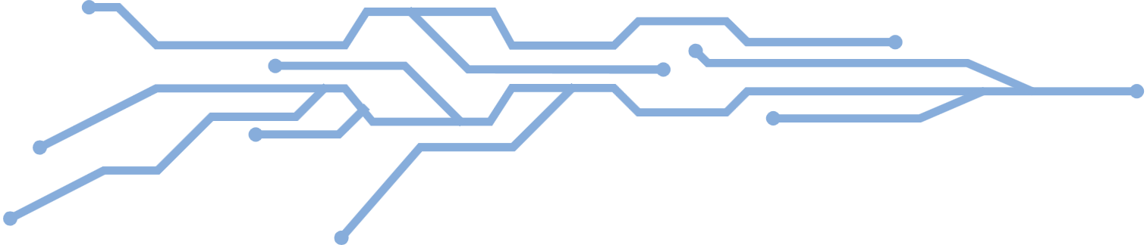
Fully Editable Shapes

Slide 14
Fully Editable Shapes

Slide 15
Fully Editable Icon Sets: A

Slide 16
Fully Editable Icon Sets: B

Slide 17
Fully Editable Icon Sets: C

